Slide 1
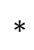
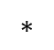
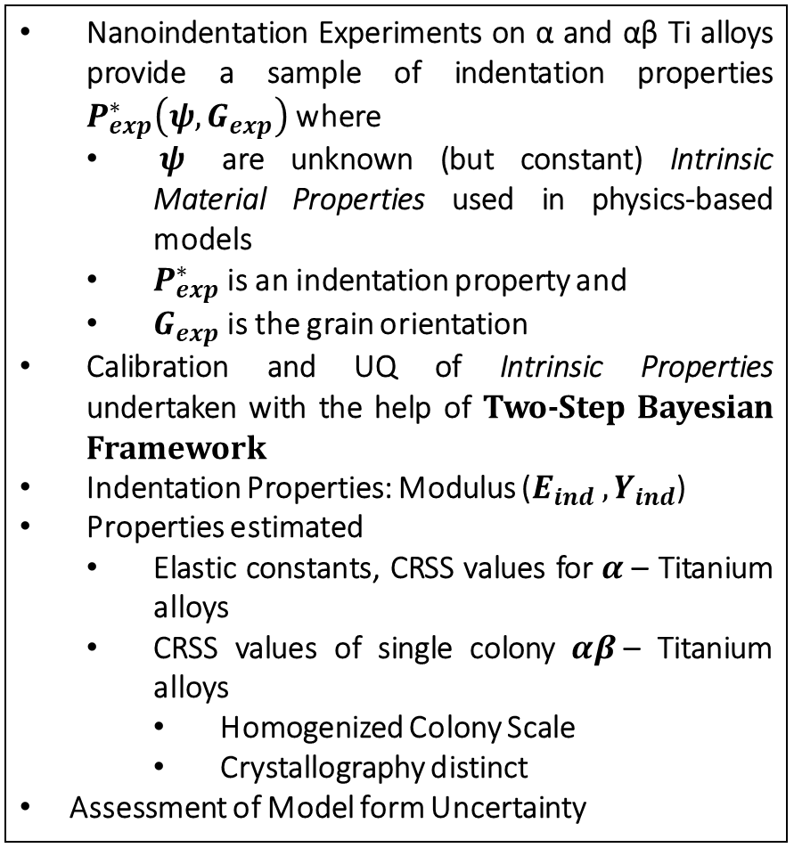
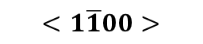
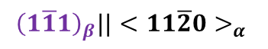
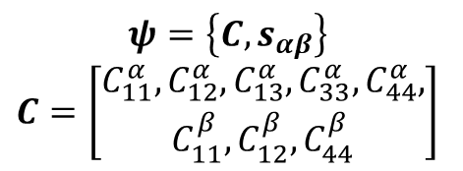
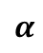
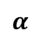
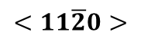

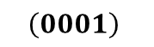
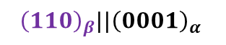
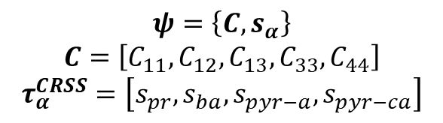
Highlights of Research Activities Pursued in Year 2: Extracting Single Crystal Elastic-Plastic Properties from Indentation Measurements
Nanoindentation Experiments on α and αβ Ti alloys provide a sample of indentation properties $P_{exp}^{∗}\left(ψ,G_{exp}\right)$ where
$ψ$ are unknown (but constant) Intrinsic Material Properties used in physics-based models
$P_{exp}^{∗}$ is an indentation property and
$G_{exp}$ is the grain orientation
Calibration and UQ of Intrinsic Properties undertaken with the help of Two-Step Bayesian Framework
Indentation Properties: Modulus ($E_{ind },Y_{ind}$)
Properties estimated
Elastic constants, CRSS values for $α$– Titanium alloys
CRSS values of single colony $αβ$– Titanium alloys
Homogenized Colony Scale
Crystallography distinct
Assessment of Model form Uncertainty
$${\left(110\right)}_{β}||{\left(0001\right)}_{α}$$
$$\left(0001\right)$$
$$α$$
$$α$$
$$∗$$
$$<11\overline{2}0>$$
$$β$$
$$∗$$
$$<1\overline{1}00>$$
$${\left(1\overline{1}1\right)}_{β}||{<11\overline{2}0>}_{α}$$
$$ψ=\left\{C,s_{α}\right\}$$
$$C=\left[C_{11},C_{12},C_{13},C_{33},C_{44}\right]$$
$$τ_{α}^{CRSS}=\left[s_{pr},s_{ba},s_{pyr−a},s_{pyr−ca}\right]$$
$$ψ=\left\{C,s_{αβ}\right\}$$
$$C=\left[\begin{aligned}C_{11}^{α},C_{12}^{α},C_{13}^{α},C_{33}^{α},C_{44}^{α}, \\ C_{11}^{β},C_{12}^{β},C_{44}^{β}\end{aligned}\right]$$
Notes:
This slide must go at the beginning

Slide 2
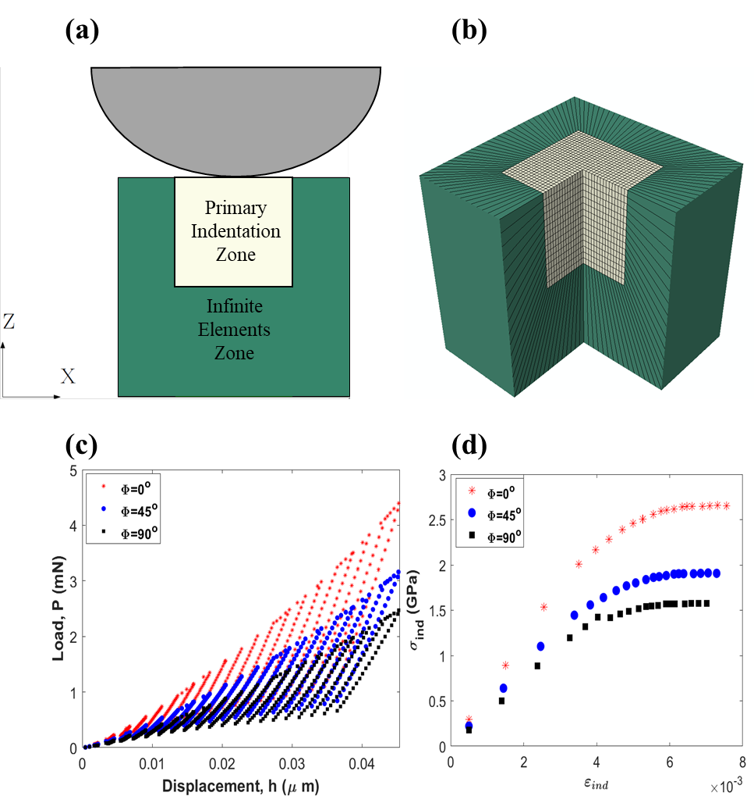
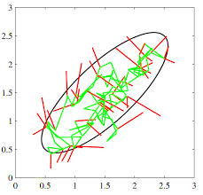
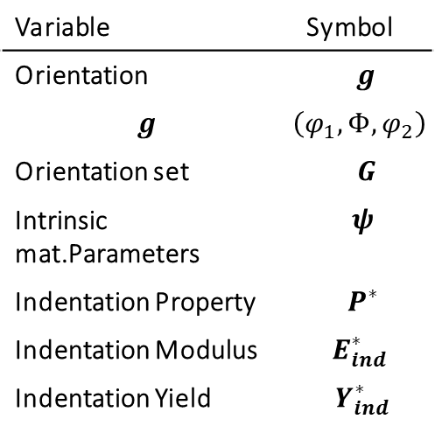
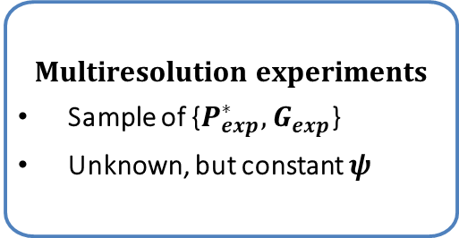
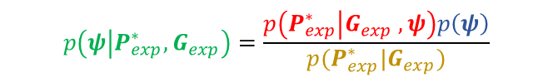


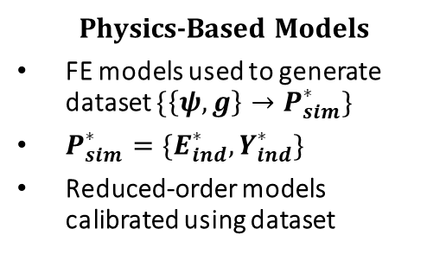
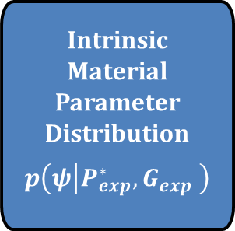
Grain Scale Intrinsic Property Extraction using the Two-Step Bayesian Framework
Physics-Based Models
FE models used to generate dataset $\{\left\{ψ,g\right\}→P_{sim}^{∗}\}$
$P_{sim}^{∗}=\{E_{ind}^{∗},Y_{ind}^{∗}\}$
Reduced-order models calibrated using dataset
Step 1
Step 2
Variable | Symbol
Orientation | $g$
$$g$$ | $$\left(φ_{1},Φ,φ_{2}\right)$$
Orientation set | $G$
$$\text{Intrinsic} \text{mat}\text{.}\text{Parameters}$$ | $$ψ$$
Indentation Property | $$P^{∗}$$
Indentation Modulus | $$E_{ind}^{∗}$$
Indentation Yield | $$Y_{ind}^{∗}$$
Reduced Order Model
Allows quick evaluations of likelihood
Intrinsic Material Parameter Distribution
$$p\left(ψ | P_{exp}^{∗},G_{exp} \right)$$
$$P_{sim}^{∗}≈\hat{P^{∗}}\left(ψ,g\right)$$
$$p\left(P_{exp}^{∗} | ψ,G_{exp} \right) ∼𝒩(P_{exp}^{∗}|P_{sim}^{∗}(ψ,G_{exp}),{\hat{Σ}}_{exp}^{P})$$
Multiresolution experiments
Sample of {$P_{exp}^{∗},$ $G_{exp}$}
Unknown, but constant $ψ$
Bayes’ theorem
MCMC Sampling
$$p\left(ψ | P_{exp}^{∗},G_{exp}\right)=\frac{p\left(P_{exp}^{∗} | G_{exp} ,ψ\right)p\left(ψ\right)}{p(P_{exp}^{∗}|G_{exp})}$$
Posterior
Likelihood
Evidence
Prior
Notes:
An overview of the 2-step Bayesian framework is shown.
The first identified gap will be accomplished by using statistical learning strategies to establish the reduced order model for the indentation property obtained using the chosen material model at an accelerated pace.
The second identified gap will be accomplished by using sampling techniques to establish the distribution of intrinsic material properties for a given set of experimental indentation property measurements
The third gap will utilize the sampled intrinsic material property distributions established in the previous step to assess the relative probabilities of various physics-based models

Slide 3
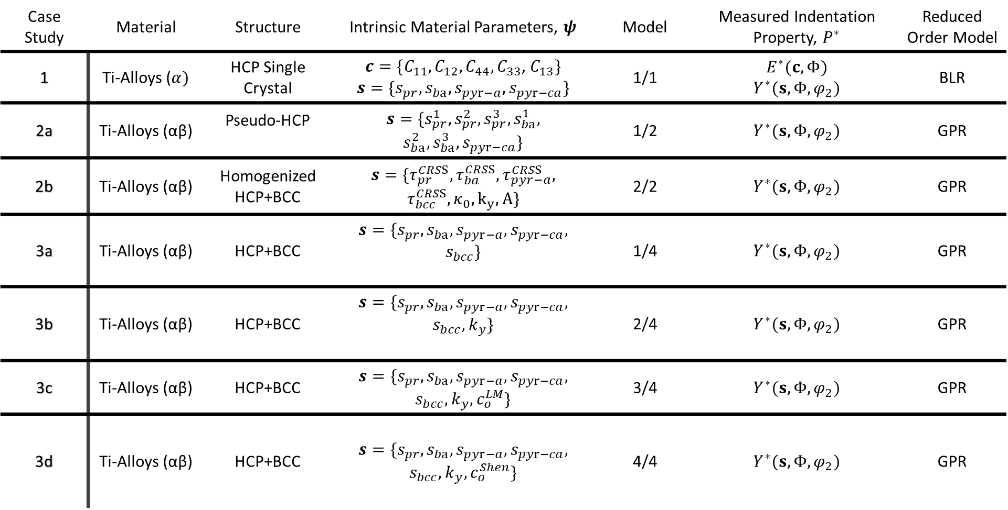
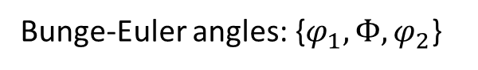
Case Studies
Case Study | Material | Structure | Intrinsic Material Parameters, $ψ$ | Model | Measured Indentation Property, $P^{∗}$ | Reduced Order Model
1 | Ti-Alloys ($α)$ | HCP Single Crystal | $$c={\{C}_{11},C_{12},C_{44},C_{33}\text{, }C_{13}\}$$ $$s=\{s_{pr},s_{ba},s_{pyr−a},s_{pyr−ca}\}$$ | 1/1 | $$E^{∗}(c,Φ)$$ $$Y^{∗}(s,Φ,φ_{2})$$ | BLR
2a | Ti-Alloys (αβ) | Pseudo-HCP | $$s=\{s_{pr}^{1},s_{pr}^{2},s_{pr}^{3},s_{ba}^{1},$$ $$s_{ba}^{2},s_{ba}^{3},s_{pyr−ca}\}$$ | 1/2 | $$Y^{∗}(s,Φ,φ_{2})$$ | GPR
2b | Ti-Alloys (αβ) | Homogenized HCP+BCC | $$s=\{τ_{pr}^{CRSS},τ_{ba}^{CRSS},τ_{pyr−a}^{CRSS},$$ $$τ_{bcc}^{CRSS},κ_{0},k_{y},A\}$$ | 2/2 | $$Y^{∗}(s,Φ,φ_{2})$$ | GPR
3a | Ti-Alloys (αβ) | HCP+BCC | $$s=\{s_{pr}, s_{ba},s_{pyr−a},s_{pyr−ca},$$ $$s_{bcc}\}$$ | 1/4 | $$Y^{∗}(s,Φ,φ_{2})$$ | GPR
3b | Ti-Alloys (αβ) | HCP+BCC | $$s=\{s_{pr}, s_{ba},s_{pyr−a},s_{pyr−ca},$$ $$s_{bcc},k_{y}\}$$ | 2/4 | $$Y^{∗}(s,Φ,φ_{2})$$ | GPR
3c | Ti-Alloys (αβ) | HCP+BCC | $$s=\{s_{pr}, s_{ba},s_{pyr−a},s_{pyr−ca},$$ $$s_{bcc},k_{y},c_{o}^{LM}\}$$ | 3/4 | $$Y^{∗}(s,Φ,φ_{2})$$ | GPR
3d | Ti-Alloys (αβ) | HCP+BCC | $$s=\{s_{pr}, s_{ba},s_{pyr−a},s_{pyr−ca},$$ $$s_{bcc},k_{y},c_{o}^{Shen}\}$$ | 4/4 | $$Y^{∗}(s,Φ,φ_{2})$$ | GPR
α
Bunge-Euler angles: {$φ_{1},Φ,φ_{2}$}
Notes:
Using the prescribed framework the estimation of grain scale intrinsic material parameters are planned for three distinct case studies.
The first case study will focus on the extraction of grain scale elastic plastic properties from the alpha constituent phase of alpha-beta Titanium alloys. This includes 5 elastic constants assuming transversely isotropic elastic behavior. And initial slip resistance values use as input into crystal plasticity constitutive models
Part A and Part B off the second case study will focus on the extraction of intrinsic material parameters for 2 crystal plasticity models for the colony lamellar face of Alpha-beta titanium alloys. further, the second case study will also focus on an assessment of the model form probability off these 2 crystal plasticity model forms.
Part 1,2,3 and four of the third case study will consider the effect off explicitly incorporating the beta laths in the finite element model for spherical nanoindentation. The number of parameters is systematically increased to determine their necessity or lack thereof in explaining the indentation property experimental observations.
the BLR and GPR technique have been utilized for the first and second case study to develop the reduced order model For the indentation properties respectively.

Slide 4
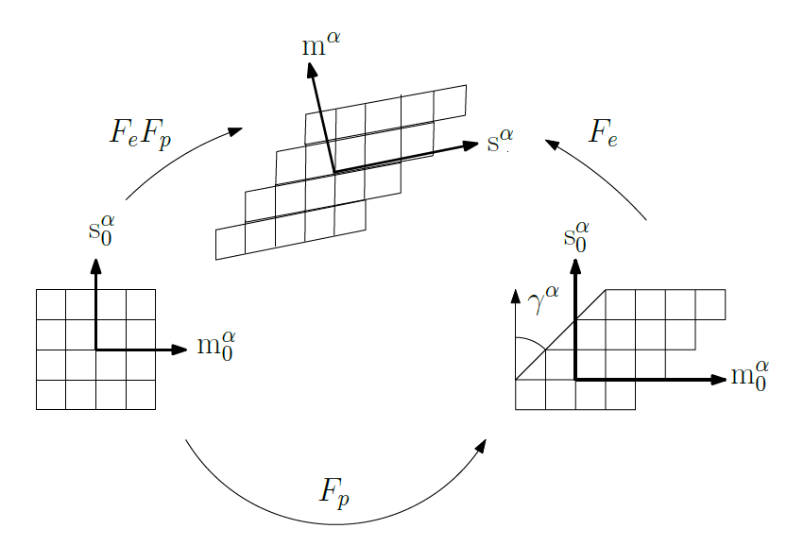
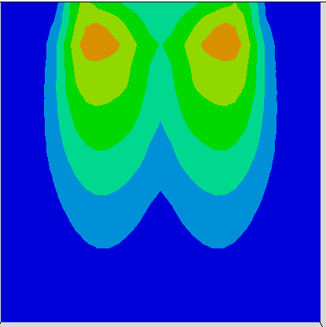
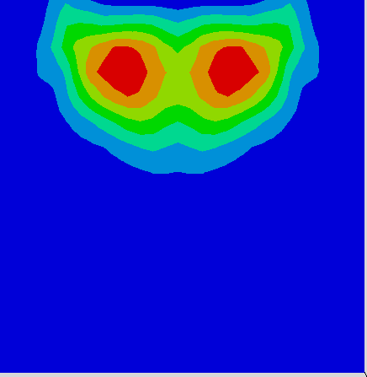
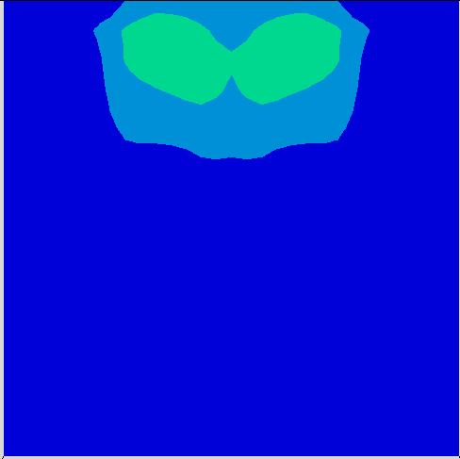
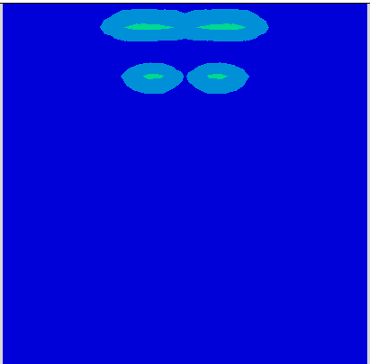
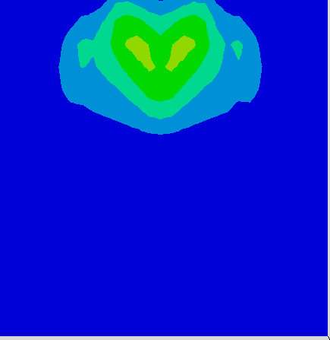
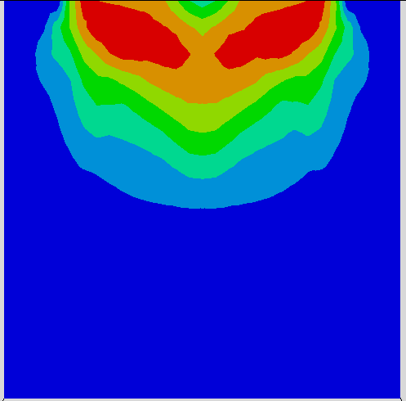
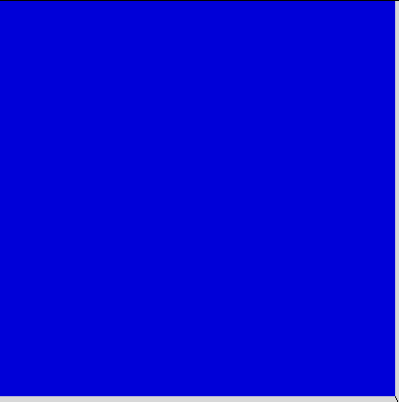


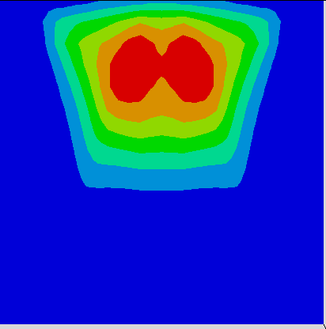


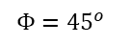
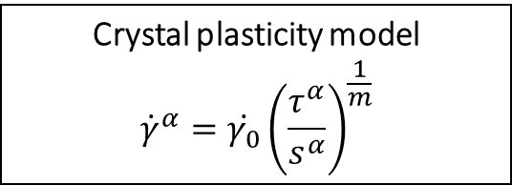
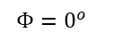
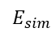
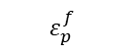
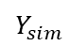
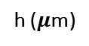
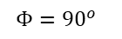
Grain Scale Intrinsic Property Extraction for α-Ti alloys
Step 1: FE simulation of spherical nanoindentation
Crystal plasticity model
$${\dot{γ}}^{α}=\dot{γ_{0}}{\left(\frac{τ^{α}}{s^{α}}\right)}^{\frac{1}{m}}$$
(a)
(c)
$$ε_{p}^{f}$$
+
6.3E
(e)
-
+
5.4E
03
-
+
4.5E
03
-
+
2.7E
03
-
+
1.8E
03
$$Φ=0^{o}$$
$$Φ={45}^{o}$$
$$Φ={90}^{o}$$
-
+
9.0E
03
-
+
0.0E
04
+00
BASAL
(d)
PRISMATIC
(b)
$$Y_{sim}$$
h ($μ$m)
PYRAMIDAL
$$E_{sim}$$
<a>
-
Primary Indentation
Zone
Infinite Elements
Zone
PYRAMIDAL
<
c+a
>
-
Notes:
The establishment of the reduced-order model needed for the calibration of the slip resistances requires data generated from physics-based models of the indentation experiment that account for the influence of the slip resistances on the indentation measurements. These physics-based models can be developed using the established crystal plasticity theories. In these models, the local deformation in a crystalline region is assumed to be accommodated exclusively by crystallographic slip on available slip systems. The slip rate depends on the imposed resolved shear stress $τ^{α}$ and is expressed as shown in the box (a), where ${\dot{γ}}_{0}$ is a reference shear rate, $m$ is the rate sensitivity parameter, and $s^{α}$ is the resistance to slip on the $α$ slip system. There are four distinct values of $s^{α}$ corresponding to each slip family in $α$ Ti alloys.
The FE model developed and utilized is designed to predict the indentation yield strength using a loading history very similar to the one used in the actual indentation experiment. In this model (shown in box (b)), infinite elements designed to simulate the effect of an infinite elastic domain were employed.
Indentation simulations were performed on hcp single crystals with selected crystallographic orientations. The load displacement curves, indentation stress-strain curves and accumulated slip in the various slip families is shown in boxes ©,(d) and (e) respectively. As expected, it is clearly seen that both the stiffness and strength are highest for the grains with the c-axis parallel to the indentation direction, which then decrease with an increase in the declination angle. The FE simulations depict this feature of the measurements observed in experiments quite well.
The plots in box (e) reveal that the declination angle has a large influence on the slip activities in the primary deformation zone of the spherical indentation. More specifically, it is observed that (i) the indentation parallel to the c-axis is dominated by pyramidal <c+a> slip activity along with a significant contribution from basal slip, and (ii) the basal and prism slip dominated the response at the higher declination angles of $\frac{π}{4}$ and $\frac{π}{2}$. Although it appears from box (e) that the basal slip dominated for the declination angle of $\frac{π}{4}$ and prism slip dominated for the declination angle of $\frac{π}{2}$, one should note that these plots can change significantly in other longitudinal sections in the same simulation, and also are expected to be sensitive to the other Bunge-Euler angle $φ_{2}$ needed to identify the grain orientation. It is generally seen that the pyramidal slip and basal slip influenced the indentation plastic response at small declination angles, while the prism slip and basal slip almost exclusively influenced the indentation plastic response at the higher declination angles.

Slide 5

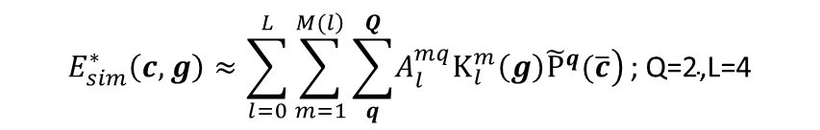





Grain Scale Intrinsic Property Extraction for α-Ti alloys
Step 1: Reduced-order Models using BLR
$$E_{sim}^{∗}\left(c,g\right)≈\sum_{l=0}^{L}{\sum_{m=1}^{\left.M(l\right)}{\sum_{q}^{Q}{\left.A_{l}^{mq}K_{l}^{m}\left(g\right){\tilde{P}}^{q}(\overline{c}\right)}}}\text{; }\text{Q}\text{=2,}\text{L}\text{=4}$$
$$\frac{Y_{sim}^{∗}}{s_{pr}}≈{\overline{Y}}^{∗}(r,g)=\sum_{l=0}^{\tilde{L}}{\sum_{m=1}^{\tilde{M}(l)}{\sum_{η}^{\tilde{Q}}{B_{l}^{mη}{\tilde{K}}_{l}^{m}\left(g\right){\tilde{P}}^{η}(\overline{r})}\text{;}\tilde{Q}\text{=}\text{1}\text{,}\tilde{L}\text{=}\text{1}\text{4}}}$$
$${\overline{r}}_{j}=\frac{2r_{j}−r_{j}^{min}−r_{j}^{max}}{r_{j}^{max}−r_{j}^{min}}, r=\left\{\frac{s_{ba}}{s_{pr}},\frac{s_{pyr−a}}{s_{pr}},\frac{s_{pyr−ca}}{s_{pr}}\right\}$$
220
200
180
160
140
120
100
80
60
40
20
20
40
60
80
100
120
140
160
180
200
220
$r=$ {$0.75≤\frac{s_{ba}}{s_{pr}}≤2.0 ,2.0≤\frac{s_{pyr−a}}{s_{pr}}≤4.5 ,2.5≤\frac{s_{pyr−ca}}{s_{pr}}≤6.5\}$
Notes:
The first step in our protocol as we recall is the establishment of reduced order models of the indentation properties using databases of physics based simulations.
On the left, The reduced order model for the indentation modulus was built using a database of 2200 Finite element simulations. The bounds of the parameter space was chosen in order to accommodate a wide variety of Ti-alloys considered in this study.
On the right, The reduced order model for the indentation yield is shown using a database of 312 crystal plasticity finite element simulations. We note the formulation of the yield function differs by normalization of the output by the prismatic slip value. We note this approach allows us to cast the problem in terms of slip resistance ratios.

Slide 6
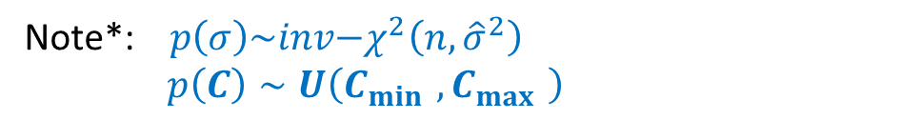
Grain Scale Intrinsic Property Extraction for α-Ti alloys
Step 2: Extracting Single Crystal Elastic Constants
Monte Carlo Markov Chain (MCMC) Sampling:
Note*: $p\left(σ\right)\sim inv\text{−}χ^{2}\left(n,{\hat{σ}}^{2}\right)$
$p\left(C\right)∼U\left(C_{\min{ }}, C_{\max{ }}\right)$
$$p\left(C,σ | A,E_{exp}^{∗},G_{exp}\right)∝p\left(E_{exp}^{∗} | C,A,G_{exp},σ\right)p(σ)p(C)$$
+/- indicates single STD from MEAN
CV=MEAN/STD (Coefficient of Variation)
*Recall only one indent per grain orientation available
Notes:
In accordance with Step 2 of our framework we can sample the posterior distribution of elastic constants of the respective alpha phase using the indents within the various Ti-alloys. We recall that in this case only a single indent per grain is available. The consequence of this is that we do not have a readily available estimate for the variance of the normally distributed likelihood. One way to address this problem is to augment the posterior distribution of interest to sample estimates of the elastic constants of interest, as well as the unknown variance. This requires the adoption of a prior for the variance. A very common prior used for an unknown variance is the scaled inverse-chi squared distribution. Using this slight modification the sampled distributions of the elastic constants for the various alloys under consideration are shown on the right. We notice that C11 C33 and C44 tend to have the sharpest distributions respectively. We also notice that estimates for CP-Ti as well as Ti-64 appear to be the most certain.

Slide 7
Grain Scale Intrinsic Property Extraction for α-Ti alloys
Step 2: Extracting Single Crystal Initial Slip Resistances
Monte Carlo Markov Chain (MCMC) Sampling:
$$p\left(s,σ | B,Y_{exp}^{∗},G_{exp}\right)∝p\left(Y_{exp}^{∗} | B,s,G_{exp},σ\right)p(σ)p(s)$$
$$p\left(s\right)∼U\left(s_{\min{ }}, s_{\max{ }}\right)$$
+/- indicates single STD from MEAN
CV=STD/MEAN(Coefficient of Variation)
*Recall only one indent per grain orientation available
Notes:
We note, a major advantage to the formulation of the reduced order model accordance to normalized indentation yield and slip ratios is that it is unnecessary to directly bound the parameter space of slip resistances during the extraction process. Thus a broad uniform distribution which only enforces the slip resistances to be strictly positive was used for the prior distribution. Using the reduced order model to evaluate the likelihood(s) multivariate MCMC chains of slip resistances were independently sampled for each alloy. With this protocol the differences between the individual initial slip resistance parameters and their associated uncertainties are readily compared across the Ti-alloys.

Slide 8
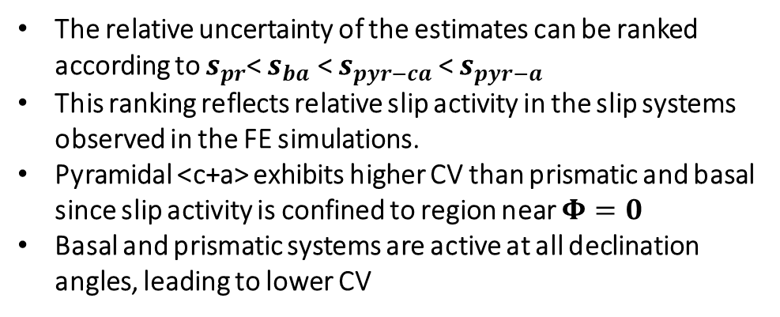
Grain Scale Intrinsic Property Extraction for α-Ti alloys
Step 2: Extracting Single Crystal Initial Slip Resistances
*CV=STD/MEAN(Coefficient of Variation)
The relative uncertainty of the estimates can be ranked according to $s_{pr}$< $s_{ba}$ < $s_{pyr−ca}$< $s_{pyr−a}$
This ranking reflects relative slip activity in the slip systems observed in the FE simulations.
Pyramidal <c+a> exhibits higher CV than prismatic and basal since slip activity is confined to region near $Φ=0$
Basal and prismatic systems are active at all declination angles, leading to lower CV
Notes:
We note in general, the relative uncertainty of the estimates can be ranked, from lowest to highest as prismatic with the lowest relative uncertainty, basal and pyramidal <c+a> exhibiting slightly more relative uncertainty and pyramidal <a> exhibiting the highest relative uncertainty. This ranking can be seen as reflective of the amount of slip activity for the slip systems across all the grain orientations experimentally indented.

Slide 9
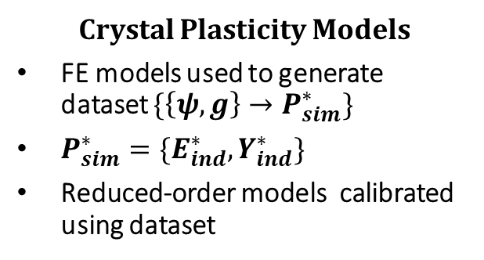
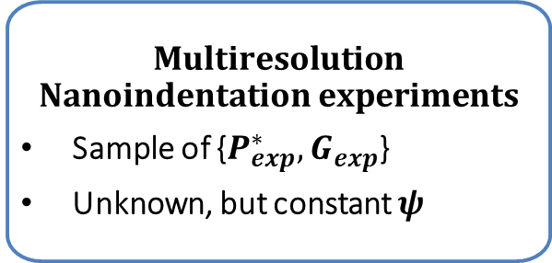
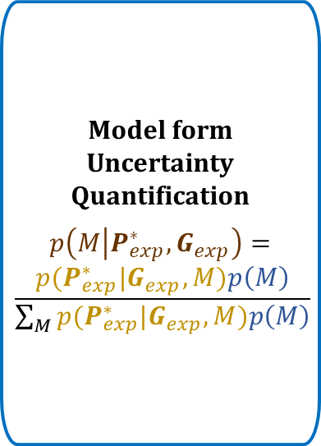
Bayesian Framework for model calibration and comparison for α-β Ti alloys
Step 1
Crystal Plasticity Models
FE models used to generate dataset $\{\left\{ψ,g\right\}→P_{sim}^{∗}\}$
$P_{sim}^{∗}=\{E_{ind}^{∗},Y_{ind}^{∗}\}$
Reduced-order models calibrated using dataset
Reduced Order Model (GPR)
Allows quick evaluations of likelihood
Model form Uncertainty Quantification
$$p\left(M | P_{exp}^{∗},G_{exp}\right)=$$
$$\frac{p(P_{exp}^{∗}|G_{exp},M)p\left(M\right)}{\sum_{M}{p(P_{exp}^{∗}|G_{exp},M)p\left(M\right)}}$$
Step 3
Step 2
MCMC Sampling
Intrinsic Material Parameter Distribution
Multiresolution Nanoindentation experiments
Sample of {$P_{exp}^{∗},$ $G_{exp}$}
Unknown, but constant $ψ$
Notes:
An overview of the Bayesian framework proposed is shown.
The first identified gap will be accomplished by using statistical learning strategies to establish the reduced order model for the indentation property obtained using the chosen material model at an accelerated pace.
The second identified gap will be accomplished by using sampling techniques to establish the distribution of intrinsic material properties for a given set of experimental indentation property measurements
The third gap will utilize the sampled intrinsic material property distributions established in the previous step to assess the relative probabilities of various physics-based models

Slide 10
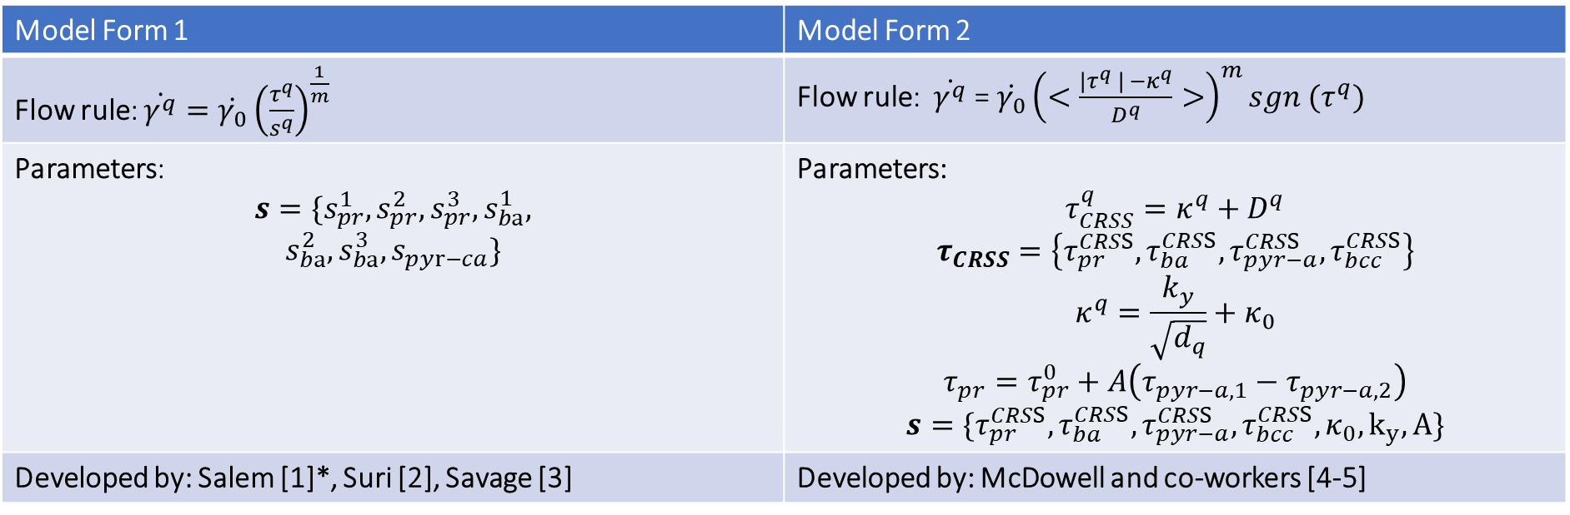
Grain Scale Intrinsic Property Extraction for α-β Ti alloys
Step 1: CP-FE Models
Model Form 1 | Model Form 2
Flow rule: $\dot{γ^{q}}=\dot{γ_{0}}{\left(\frac{τ^{q}}{s^{q}}\right)}^{\frac{1}{m}}$ | Flow rule: $\dot{γ^{q}}$ = $\dot{γ_{0}}{\left(<\frac{{|τ}^{q} | −κ^{q}}{D^{q}}>\right)}^{m}sgn (τ^{q})$
Parameters: $$s=\{s_{pr}^{1},s_{pr}^{2},s_{pr}^{3},s_{ba}^{1},$$ $$s_{ba}^{2},s_{ba}^{3},s_{pyr−ca}\}$$ | Parameters: $$τ_{CRSS}^{q}=κ^{q}+D^{q}$$ $$τ_{CRSS}=\left\{τ_{pr}^{CRSS},τ_{ba}^{CRSS},τ_{pyr−a}^{CRSS},τ_{bcc}^{CRSS}\right\}$$ $$κ^{q}=\frac{k_{y}}{\sqrt{d_{q}}}+κ_{0}$$ $$τ_{pr}=τ_{pr}^{0}+A\left(τ_{pyr−a,1}−τ_{pyr−a,2}\right)$$ $$s=\{τ_{pr}^{CRSS},τ_{ba}^{CRSS},τ_{pyr−a}^{CRSS},τ_{bcc}^{CRSS},κ_{0},k_{y},A\}$$
Developed by: Salem [1]*, Suri [2], Savage [3] | Developed by: McDowell and co-workers [4-5]
A. Salem, L. Semiatin Mat. Sci. and Eng.: A 508(1) (2009) 114-120
M.F. Savage, J. Tatalovich, M.J. Mills, Philos Mag 84(11) (2004) 1127-1154.
S. Suri, G.B. Viswanathan, T. Neeraj, D.H. Hou, M.J. Mills, Acta Mater. 47(3) (1999) 1019-1034.
F. Bridier, D.L. McDowell, P.P. Villechaise, J. Mendez, Int. J. of Plast. 25(6) (2009) 1066-1082.
J.R. Mayeur, D.L. McDowell, R.W. Neu, Comput. Mater. Sci. 41(3) (2008) 356-365.

Slide 11
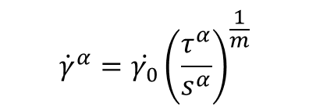
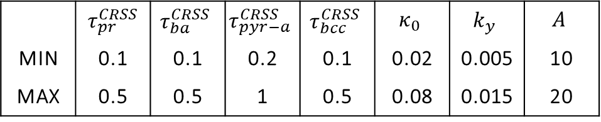
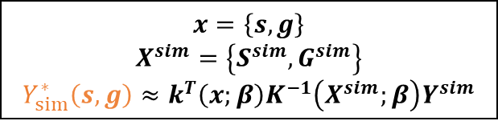
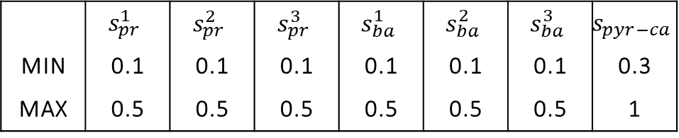
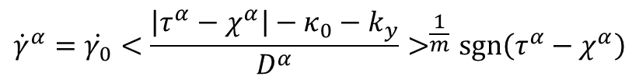
Grain Scale Intrinsic Property Extraction for α-β Ti alloys
Step 1: Reduced-order Models using GPR
$${\dot{γ}}^{α}=\dot{γ_{0}}{\left(\frac{τ^{α}}{s^{α}}\right)}^{\frac{1}{m}}$$
$${\dot{γ}}^{α}=\dot{γ_{0}}<\frac{\left|τ^{α}−χ^{α}\right|−κ_{0}−k_{y}}{D^{α}}>^{\frac{1}{m}}sgn\left(τ^{α}−χ^{α}\right)$$
$$x=\left\{s,g\right\}$$
$$X^{sim}=\left\{S^{sim},G^{sim}\right\}$$
$$Y_{sim}^{∗}\left(s,g\right)≈k^{T}\left(x;β\right)K^{−1}\left(X^{sim};β\right)Y^{sim}$$
 | $$s_{pr}^{1}$$ | $$s_{pr}^{2}$$ | $$s_{pr}^{3}$$ | $$s_{ba}^{1}$$ | $$s_{ba}^{2}$$ | $$s_{ba}^{3}$$ | $$s_{pyr−ca}$$
MIN | 0.1 | 0.1 | 0.1 | 0.1 | 0.1 | 0.1 | 0.3
MAX | 0.5 | 0.5 | 0.5 | 0.5 | 0.5 | 0.5 | 1
 | $$τ_{pr}^{CRSS}$$ | $$τ_{ba}^{CRSS}$$ | $$τ_{pyr−a}^{CRSS}$$ | $$τ_{bcc}^{CRSS}$$ | $$κ_{0}$$ | $$k_{y}$$ | $$A$$
MIN | 0.1 | 0.1 | 0.2 | 0.1 | 0.02 | 0.005 | 10
MAX | 0.5 | 0.5 | 1 | 0.5 | 0.08 | 0.015 | 20
Notes:
The first step in our protocol as we recall is the establishment of reduced order models of the indentation properties using databases of physics-based simulations.
The flow rules for both models Is shown here. In addition to the flow rules, the models also differ in the set of slip systems considered.
The reduced order model has been built for both model farms using gaussian process regression . It is A nonparametric nonlinear interpolation technique well suited to emulate complex response surfaces.
the textbox briefly mentions the relevant equations.
On the left, The reduced order model for the indentation yield obtained using model-1 was built using a database of 170 Finite element simulations.
On the right, The reduced order model for the indentation yield obtained using model-2 is shown using a database of 180 crystal plasticity finite element simulations.
The bounds of the parameter space was chosen in order to accommodate a wide variety of ab-Ti alloys considered in this study. You can see that the GPR model is capable of accurately predicting the indentation yield.
this quick emulator will be used to perform numerous evaluations of the likelihood function during MCMC sampling.

Slide 12


Grain Scale Intrinsic Property Extraction for α-β Ti alloys: Step 2
Model 1
Model 2
Parameter | Literature Vales | MEAN | STD | CV
$$s_{pr}^{1}$$ | 231 | 279 | 25 | 0.09
$$s_{pr}^{2}$$ | 231 | 388 | 37 | 0.1
$$s_{pr}^{3}$$ | 231 | 387 | 39 | 0.1
$$s_{ba}^{1}$$ | 354 | 264 | 27 | 0.1
$$s_{ba}^{2}$$ | 354 | 363 | 39 | 0.11
$$s_{ba}^{3}$$ | 354 | 362 | 41 | 0.12
$$s_{pyr−ca}$$ | 805 | 775 | 87 | 0.12
Parameter | Literature Vales | MEAN | STD | CV
$$τ_{pr}^{CRSS}$$ | 231 | 277 | 37 | 0.13
$$τ_{ba}^{CRSS}$$ | 354 | 376 | 45 | 0.12
$$τ_{pyr−a}^{CRSS}$$ | 490 | 782 | 83 | 0.10
$$τ_{bcc}^{CRSS}$$ | 319 | 198 | 31 | 0.16
$$κ_{0}$$ | 50 | 51 | 6 | 0.12
$$k_{y}\left(MPa mm^{−\frac{1}{2}}\right)$$ | 12 | 11 | 2* | 0.18
$$A(MPa/MPa)$$ | 15 | 15 | 2* | 0.14
Notes:
Using the reduced order model to evaluate the likelihood(s) multivariate MCMC chains of slip resistances were independently sampled. Also shown are best prior values obtained from literature.
With this protocol the differences between the individual initial slip resistance parameters and their associated uncertainties can be readily compared across various ab-Ti-alloys. We note in general, the relative uncertainty of the estimates can be ranked, from lowest to highest as prismatic with the lowest relative uncertainty, basal and pyramidal <c+a> exhibiting slightly more relative uncertainty and pyramidal <a> exhibiting the highest relative uncertainty. This ranking can be seen as reflective of the amount of slip activity for the slip systems across all the grain orientations experimentally indented. the basal and prismatic slip resistances or higher than the Alpha titanium case. this could be due to the fact that we're ignoring pyramidal <a> systems in the analysis. in the case of Alpha titanium, The pyramidal <a> systems are active at large declination angles. the anisotropy in the individual basil and prismatic slip systems could be elevated due to this simplification
Similar to Model 1 we use the robust adaptive Metropolis algorithm to compute the intrinsic material parameter posterior distributions for model 2.
The relative uncertainties in the crss values were in the order of ba<pris<pyr-a<bcc..
The pyramidal <a> was forced to activate in this model at $Φ=0$ due the lack of pyr. <c+a> slip systems, resulting in a clear resolution of its effect. Further, this caused its mean value to be about 33% higher than the $α$ counterpart.
The BCC slip systems were active throughout, but their effect was predominant only at the trough/dip. This could explain why the relative uncertainties are higher.
The basal and prismatic are also active throughout and showed similar levels of slip activity, explaining the observations regarding their uncertainties.
Due to precision issues the uncertainties in the Hall Petch coefficient and the coefficient A which accounts for tension compression asymmetry, are comparatively higher as compared to the CRSS values
The transformed BCC colonies’ CRSS was estimated to b substantially lower than the prior value and it has important consequences regarding the ability of the model to adapt to the indentation yield profile (next slide)

Slide 13



Grain Scale Intrinsic Property Extraction for α-β Ti alloys
Step 2: Insights
Model 1
Model 2
Comparison shown b/w
Experiments ●,
FE simulations using prior values for parameters obtained from literature (red Δ) and
Mean posterior estimates obtained from the current protocol (blue □).
Simulations show substantially improved predictions (obtained on a regular grid of 15º)
For Model-1
Prism-1 and Basal-1 activity were highest at $Φ=60^{o}$
For Model-2
BCC CRSS estimate significantly lower than prior estimate
Maximal BCC relative slip activity corresponds to trough
Basal and Prismatic exhibit relatively higher amounts of slip activity at higher declination angles, hence the rise
Notes:
the figure on the bottom right shows the comparison between experimental and two cases of FE simulations obtained nanoindentation yield data for the colony phase titanium. One case (red triangles ) are best prior estimates ) and the blue values are posterior estimates obtained from the mcmc sampling; one can clearly see substantial improvement in the goodness of fit
in Model 1, the basil and prismatic slip systems are active at all declination angles. We note that the distribution of slip activity amongst the individual basil and prismatic step systems determines the effective indentation yield.
It was apparent from the FE simulations that the relative slip activity in the prism-1 and basal-1 were highest at 60 deg. For the simulations we conducted. This correlates well with the observed trends in indentation yield.
For model 2, posterior estimates are again seen to be much better than prior estimates. One of the key differences between the prior estimates and the posterior estimates is that the CRSS value of the transformed BCC colonies is significantly lower. This this allowed us to fit the indentation profile better since the trough corresponds to zones where the BCC slip activity is relatively the highest amongst the operative slip systems.

Slide 14




Step 3: Crystal Plasticity Model Form UQ for α-β Ti alloys
No prior assessments available→ we assume the priors to be .5.
Overall model 2 is relatively more probable based on the evidence.
Significant disparities exist in the model performances across $0<Φ<\frac{π}{2}$
Model 1 significantly outperforms Model 2 in $0<Φ<\frac{π}{6}$ whereas the reverse is true in $\frac{π}{3}<Φ<\frac{π}{2}$
No strong conclusion in $\frac{π}{6}<Φ<\frac{π}{3}$ where there is a dip in the indentation profile.
$∵$ in both cases, the slip systems with the lowest CRSS exhibit the highest slip activity in the trough, and there are enough slip systems to adapt to the indentation response.
A composite surrogate model that exhibits the best characteristics of the surrogate models developed from the individual physics-based models is desirable
Information Fusion approaches followed to build a linear interpolator that minimizes the overall variance in the predicted response
Model | Probability | RMSE (GPa) | Bayes’ Factor | Zone
1 | 0.28 | 0.12 | 2.57 | $$0<Φ<\frac{π}{2}$$
2 | 0.72 | 0.09 | 0.38 | $$0<Φ<\frac{π}{2}$$
Model Form Probability vs $Φ$
1
Model 1
y
Model 2
t
0.8
i
l
i
b
a
b
o
0.6
r
P
m
r
o
F
0.4
l
e
d
o
M
0.2
0
π/6
π/3
π/2
0
Declination angle - $Φ$

Slide 15












Step 3: UQ Based Information Fusion for α-β Ti alloys
Requirements:
A set of candidate models for QoI $y$
$y^{∗}=f_{i}\left(x\right)+ε_{i}\left(x\right);i=\left\{1,2,3…\right\}$
Model-model correlation matrix $Σ$
$Σ_{ij}\left(x\right)=corr \left(f_{i}\left(x\right),f_{j}\left(x\right)\right)=ρ_{ij}σ_{i}σ_{j}$
Formulation: $y^{∗}={w(x)}^{T}f(x)$
$w\left(x\right)$ are weights assigned to each model
$f\left(x\right)={\left[f_{1}\left(x\right),f_{2}\left(x\right),…\right]}^{T}$
Problem: Find $w(x)$ such that variance of the fused estimate is minimized (dropping $(x)$)
$w^{∗}=\arg{\min_{w}{w^{T}Σw}}$
$y^{∗}∼𝒩\left(\frac{1^{T}Σ^{−1}f}{1^{T}Σ^{−1}1},\frac{1}{1^{T}Σ^{−1}1}\right)$
$$P_{sim}^{∗}(ψ,g,M_{1})$$
$$P_{sim}^{∗}(ψ,g,M_{2})$$
$$P_{sim}^{∗}(ψ,g,M_{n})$$
$$ψ_{1}$$
$$ψ_{2}$$
$$ψ_{n}$$
$${\hat{P}}_{sim}^{∗}(g,M_{1})$$
$${\hat{P}}_{sim}^{∗}(g,M_{2})$$
$${\hat{P}}_{sim}^{∗}(g,M_{n})$$
$${\hat{P}}_{sim}^{f}\left(g\right)=w^{T}(g){\hat{P}}_{sim}^{∗}(g,M)$$

Slide 16

















Research Goals for Year 3: Role of Phase Boundary in α-β Ti alloys
β laths are treated in a homogenized manner in CP-FE treatments of colony phase.
This could potentially obfuscate the importance of the phase boundary with regards to property predictions.
Other issues to address length scale effects, volume fraction of β laths and
CP-FE Nanoindentation with the laths explicitly incorporated into the FE mesh allows us to systematically probe these effects
Microstructure Characterization
FE Mesh Generation
BOR
-2000
e₃
$$Q^{s→α}$$
$$e_{3}^{α}$$
$$ρ$$
0
$$Q^{α→s}$$
$$e_{2}^{α}$$
2000
e₁
e₂
$$e_{1}^{α}$$
-90
-45
0
45
90
$$Q^{s→β}$$
$$Q^{β→α}$$
$θ$(degrees)
$$Q^{β→s}$$
$$e_{2}^{β}$$
$$e_{1}^{β}$$
$$Q^{α→β}$$
$$e_{3}^{β}$$
$$θ=43.6^{o}$$
0.4
Volume fraction,
Lath thickness
y
0.3
t
i
l
i
b
a
0.2
b
o
r
P
0.1
Voxelization
FE mesh generation
0
0
0.2
0.4
0.6
0.8
Lath thickness ($μ$
m)
Notes:
Up until now, we have homogenized the beta laths and treated the entire colony as an effective single crystal. this treatment is incapable of accounting for the effects of the phase boundary on the mechanical response, thereby obfuscating its importance.
Further, impediments to dislocation motion such as reduced mean free path and the volume fraction of the beta laths must be accounted for in a more precise manner
therefore we explore the utility of explicitly incorporating the beta laths in the FE mesh for spherical nanoindentation.
The generation of the FE mesh entailed the following steps:
To procure the volume fractions and the lap thicknesses from the available samples, we first binarized the SEM images of single colony samples to obtain the volume fraction of the beta phase , following which we apply a Hough transform to obtain the orientation of the laths.
Next we utilize angularly resolved chord length distributions to estimate the mean lath thickness.
We then utilized the estimated volume fraction and lath thickness, along with the BOR to calculate the phase boundary normal in an arbitrary global frame, given the euler angles of the alpha phase.
The indentation domain is sliced with sufficient number of laths with the estimated thickness to satisfy the computed volume fraction.
The domain is then voxelized and surround the indented domain with infinite elements to complete the FE mesh generation

Slide 17




Research Goals for Year 3: Role of Phase Boundary in α-β Ti alloys
A multitude of choices exist with regards to modeling the interaction between the two phases.
These choices are represented in the form of penalties that increase the CRSS $s^{k}$ for unfavorably oriented pair of slip systems across the phase boundary (GTF, Hall-Petch).
Consider Pair of slip systems across the αβ interface - $k,k^{′}$.
Hall Petch Penalty for hard-glide oriented systems
Geometric Transfer Factors (GTF)
Luster-Morris $\left(P^{kk^{′}}\right)$
Shen $\left(P^{kk^{′}}\right)$
Goal is to evaluate these penalties in explaining the nanoindentation response at the effective colony scale in terms of necessity and efficacy
Penalties systematically added and effect on response critically evaluated
Crystal Plasticity Model forms
$$s=\left\{s_{pris}^{α},s_{bas}^{α},s_{pyr<a>}^{α},s_{pyr<c+a>}^{α},s_{0}^{β},k_{y},c_{0}\right\}$$
$$\hat{s^{k}}=s^{k}+\frac{k_{y}}{\sqrt{d^{k}}}+c_{o}\max\left(1−\left|P^{kk^{′}}\left(θ,ψ,δ,γ,κ\right)\right|\right)$$
β
α
$$γ$$
$$δ$$
k’
k
GTF/RBV
CRSS Values
Hall-Petch
Notes:
Several gaps exist in the description of slip transfer across the alpha-beta interface.
To explain the experimental slip transfer observations, researchers have proposed a multitude of criteria that consider the relative alignment or misalignment between pair of slip systems across the αβ interface.
They can be Geometric Transfer Factors or Hall-Petch type relations, in addition to criteria that set lower bounds on resolved shear stresses on the phase boundary plane to activate slip transfer
We seek to evaluate whether these parameters are necessary and if so, their capability to explain nanoindentation mechanical response
These penalties are systematically added to the initial CRSS and the resultant model are chosen for exploration

Slide 18


Research Goals for Year 3: Role of Phase Boundary in α-β Ti alloys
CP-FE Models
CRSS penalization added as follows:
${\hat{s}}^{α,k}=s^{α,k}+\frac{k_{y}}{√(d_{k})}+c_{0}\left(1−\max{P^{kk^{′}}}\right)$
${\hat{s}}^{β,k^{′}}=s^{β,k^{′}}+\frac{k_{y}}{√(d_{k^{′}})}+c_{0}\left(1−\max{P^{k^{′}k}}\right)$
CRSS = Initial CRSS + Hall-Petch Penalty + Misorientation Penalty
4 Model forms
Model 1: $s=\left\{s_{pris}^{α},s_{bas}^{α},s_{pyr<a>}^{α},s_{pyr<c+a>}^{α},s_{0}^{β}\right\}$
Model 2: $s=\left\{s_{pris}^{α},s_{bas}^{α},s_{pyr<a>}^{α},s_{pyr<c+a>}^{α},s_{0}^{β},k_{y}\right\}$
Model 3: $s=\left\{s_{pris}^{α},s_{bas}^{α},s_{pyr<a>}^{α},s_{pyr<c+a>}^{α},s_{0}^{β},k_{y},c_{0}\right\}$ (with Luster-Morris Misorientation Penalty)
Model 4: $s=\left\{s_{pris}^{α},s_{bas}^{α},s_{pyr<a>}^{α},s_{pyr<c+a>}^{α},s_{0}^{β},k_{y},c_{0}\right\}$ (with Shen Misorientation Penalty)
Crystal Plasticity Model forms
$$s=\left\{s_{pris}^{α},s_{bas}^{α},s_{pyr<a>}^{α},s_{pyr<c+a>}^{α},s_{0}^{β},k_{y},c_{0}\right\}$$
$$\hat{s^{k}}=s^{k}+\frac{k_{y}}{\sqrt{d^{k}}}+c_{o}\max\left(1−\left|P^{kk^{′}}\left(θ,ψ,δ,γ,κ\right)\right|\right)$$
β
α
$$γ$$
$$δ$$
k’
k
GTF/RBV
CRSS Values
Hall-Petch
Notes:
As mentioned in the previous slide, penalties are systematically added to the initial CRSS and the resultant model are chosen for exploration
We consider 4 model forms in the study to evaluate the effect and necessity of these penalties .
the first model form considers only the CRSS values of the four slip families of the secondary α and the β phase
The Second model form incorporates a Hall-Petch type penalty for the CRSS values in order to penalize slip systems whose glide directions intersect the phase boundary
The third and 4th model forms incorporate common reduced order relations used in experimental literature to explain slip transfer observations in polycrystals.
We note, this represents essentially a doubling of the computational effort from the previous study wherein we considered only two model forms. We therefore utilize fusion approaches to accelerate the assessment of these model forms

Slide 19





Research Goals for Year 3: Role of Phase Boundary in αβ Ti alloys
Proposed Approach
GTF/RBV/HP are reduced order relations that can be incorporated into CP-FE analyses
Performance may not be uniform $∀Φ$. How do we estimate overall utility of each relation and applicability across $Φ$ ?
Two approaches explored:
Individual calibration and model form UQ (explained previously)
Fused calibration exploiting parametric commonality
CP-FE Models and ROMs
FE models used to generate dataset {$P_{sim}^{∗},S_{sim},G_{sim}\}$
Reduced-order models (ROMs) ${\hat{P}}^{r}(s,g)$ built using for each model form ‘$r$’
Captures dependency on $S_{sim} \& G_{sim}$
Step 1
Fused ROM ${\hat{P}}^{f}(s,g)$
Incorporating inter-model correlations
Step 3
Step 2
Model form Uncertainty Quantification
$$p\left(M^{r} | P_{exp}^{∗},G_{exp}\right)=\frac{I^{r}\left({\hat{P}}^{f}(P_{exp}^{∗},G_{exp})\text{,}{\hat{P}}^{r}(P_{exp}^{∗},G_{exp})\right)}{\sum_{r}{I^{r}\left({\hat{P}}^{f}(P_{exp}^{∗},G_{exp})\text{,}{\hat{P}}^{r}(P_{exp}^{∗},G_{exp})\right)}}$$
MCMC Sampling using Fused ROM
Common Set of Intrinsic Material Parameter Distributions
Multiresolution Experiments
Sample of {$P_{exp}^{∗},$ $G_{exp}$}
Prior Knowledge: $p\left(s\right),p(M)$
Notes:
Several gaps exist in the description of slip transfer across the alpha-beta interface
These GTf/RBV/Hall-Petch criteria are Reduced order relations that attempt to explain slip transfer and they may not be applicable throughout the input domain ($Φ$) to explain slip transfer observations
CP-FE models do not consider the unit dislocation interactions such as absorption, dissociation, annihilation, etc…
Can we explain observations by fusing the available models?
Two approaches explored:
Treat them as separate models and assess model forms after individual calibration steps (as in the effective case)
Exploit parametric commonality to build fused models and calibrate a common set of reconciled parameters

Slide 20



Appendix Slides from here: Not to be included in the main ppt! Gaps in Extraction of grain-scale elastic-plastic intrinsic properties via Spherical Indentation Measurements
Several sources of uncertainty exist w.r.t calibration of intrinsic parameters
Experimental noise
Multiple physics-based models
Systematic discrepancy
Numerical approximation errors
This uncertainty is expressed through $p\left(ψ\right)$ where $ψ$ are the intrinsic parameters.
How to quantify uncertainty $p\left(ψ\right)$ ?
How to guide data gathering to minimize $p\left(ψ\right)$ ?
The adaptation of a Bayesian Framework can play a crucial role in systematically addressing these issues
Indentation Modulus [Gpa]
Declination angle $Φ$
Notes:
Add Task List:
Tools have been used in various fields, so this is now a task…
Develop Bayesian framework: … etc etc.
Efficiently establish ROM…. And establish estimates using experiments with higher confidence
The gaps identified from the following list
One: Several sources of uncertainty exist w.r.t calibration of intrinsic parameters from physics-based models
Inherent noise present in experimental indentation measurements
Multiple physics-based descriptions of constitutive behavior exist for these alloys (especially for the colony phase) causing an uncertainty in the parameter sets as well as their physical meaning
Systematic discrepancy w.r.t observations due to incomplete/inaccurate physics caused by the presence of $α−β$ phase boundary. Note: CP models don’t incorporate the unit dislocation interactions at the boundary
Numerical approximation errors (infinitely large samples as required by Hertz theory don’t exist) ;
Therefore, robust methods are necessary to quantify the uncertainty of the intrinsic material parameters as well as the uncertainty in the constitutive descriptions.
Both of these are dependent on $p\left(ψ\right)$ where $ψ$ are the intrinsic parameters. So, our main goal is to obtain quantitative assessments of uncertainty in $p\left(ψ\right)$
Additionally, There is no rigorous framework to identify the experiment/simulation which offers the most information toward the extraction of intrinsic material parameters. Ascertainment of the experiments that offer the most information toward establishing these intrinsic parameters would significantly lower the overall cost incurred.
We propose the adoption of a bayesian framework will play a crucial role in systematically addressing these issues

Slide 21



Extracting Materials Knowledge From Multiscale Observations using the Bayesian Framework
$$p\left(ψ | P_{exp}^{∗},G_{exp},M\right)=\frac{p\left(P_{exp}^{∗} | G_{exp} ,ψ,M\right)p\left(ψ\right)}{p(P_{exp}^{∗}|G_{exp},M)}$$
$$p\left(M | P_{exp}^{∗},G_{exp}\right)=\frac{p(P_{exp}^{∗}|G_{exp},M)p\left(M\right)}{\sum_{M}{p(P_{exp}^{∗}|G_{exp},M)p\left(M\right)}}$$
Establish the Posterior distribution of intrinsic material parameters and Model form Probabilities
The Likelihood described the probability of experimental observations for an arbitrary set of intrinsic properties or chosen model form
The Prior enables incorporation of previous (expert) knowledge of the parameter/model
The Model Evidence is a normalizing constant
Each Model is associated with a set of intrinsic parameters
Maximize Information gain between Prior and Posterior for a given Model
Objective selection of additional experiments $P_{exp}^{∗},G_{exp}$
The Prior is now the current known distribution of intrinsic material parameters
Maximize the potential difference between Posterior and Prior distributions (return later)
Notes:
In the Bayesian setting the goal is to establish the distribution of intrinsic material parameters
--since this is impossible to establish directly using purely experiments, we can apply bayes rule to break the process into pieces
--The first and major piece is the likelihood function. Ideally this component allows us to define the probability for some experimental observations for an arbitrary set of intrinsic properties
-- The second piece is the prior. This contains domain specific knowledge, for example this can be used to consider only sets of intrinsic material parameters which are physically possible
-- The last component is the evidence which is a normalizing constant whichis typically unnecessary to compute directly in Bayesian methods.
One of the advantages of casting the framework in this manner is the ability to leverage information based methods to accelerate the extraction effort
-- We note these acceleration efforts are performed by maximizing the potential difference between our prior information and the poster distribution of intrinsic properties. This will be covered more in depth later

Slide 22

Establishing the Likelihood Function
$p\left(P_{exp}^{∗} | ψ,G_{exp} ,M\right)$ $=𝒩(P_{exp}^{∗}|P_{sim}^{∗}(ψ,G_{exp},M),{\hat{Σ}}_{exp}^{P})$
The likelihood function is directly evaluated through the simulations of the indentation experiment.
Assumes the experimentally measured indentation property is normally distributed
mean given by the “ground truth” simulated indentation property FE model
covariance of the indentation process estimated using experimental data.
RHS is intractable analytically/numerically
Markov Chain Monte Carlo (MCMC) Sampling allows estimation up to a normalizing constant (Model Evidence )
Markov chain length, $n$, must be large
Use reduced order models (ROMs) to capture the knowledge learned in simulations.
Notes:
The main component missing is the likelihood function
-Again this is the probability of the observed experimental indentation property measurements for a set of intrinsic material parameters.
-We can view the measured experiments as being normally distributed about an expected ground truth indentation property provided by simulations
-In the case, the ground truth, or the mean of the distribution is provided by a suitable finite element simulation
-The variance is computed directly from experimentally observed data
Often, This likelihood function is very difficult to integrate analytically or numerically. therefore we resort to markov chain Monte Carlo sampling techniques to estimate the posterior distributions of the intrinsic parameters up to a normalizing constant
We note that the markov chain requires a large amount of evaluations. So instead of using purely finite element simulations, we can instead use a high fidelity reduced order model.

Slide 23


ROM Building approaches
Bayesian Linear Regression (BLR)
Gaussian Process Regression (GPR)
$P_{sim}^{∗}≈\hat{P^{∗}}\left(ψ,g\right)=\sum_{l=0}^{L}{\sum_{m=0}^{M(l)}{\sum_{q=0}^{Q}{A_{l}^{mq}K_{l}^{m}\left(g\right){\overline{P}}^{q}(\overline{ψ})}}}$
Goal is to establish model coefficients $A=\left\{A_{l}^{mq}\right\}$
$p\left(A | {P_{sim}^{∗},Ψ}_{sim},G_{sim}\right)∝p\left(P_{sim}^{∗} | A,Ψ_{sim},G_{sim}\right) p(A)$
$p\left(P_{sim}^{∗} | A,Ψ_{sim},G_{sim}\right)=\prod_{i}^{N}{\left.𝒩(P_{i}^{∗}|{\hat{P}}^{∗}(ψ_{i},g_{i}),A\right)}$
Nonparametric ROM technique
Goal is to establish $\hat{P}\left(ψ,g\right)$ directly
$X_{sim}=\left\{Ψ_{sim},G_{sim}\right\};x=\left\{ψ,g\right\}$
$p\left(P_{sim}^{∗} | Ψ_{sim},G_{sim}\right)=𝓝\left(0, Σ_{sim}^{P}\right)$
${\hat{P}}^{∗}(x)∼𝒩\left(m\left(x\right),s(x)\right)$
$m\left(x\right)=Σ\left(x,X_{sim}\right){\left(Σ_{sim}^{P}\right)}^{−1}P_{sim}^{∗}$
$s\left(x\right)=Σ\left(x,x\right)− Σ\left(x,X_{sim}\right) {\left(Σ_{sim}^{P}\right)}^{−1}Σ\left(X_{sim},x\right)$
Notes:
Here shown is the reduced order model previously introduced.
In our studies, we have followed two approach to establish the ROM. The first is called Bayesian Linear Regression or BLR.
In this approach, we seek to establish the coefficients of the linear model, denoted by A, using a database of finite element simulations
One way to pursue this task is by treating the model coefficients as stochastic variables and inferring the distribution of model coefficients.
We have adopted a similar model form used in previous works. Below we show a linear model which composes of families of orthonormal basis functions representing the orientation of the material underneath the indenter and the intrinsic material parameters. We will come back to this later. (Stop here for simplicity, if needed describe more)
Specifically Legendre polynomials, symbolized by K, are used to represent the intrinsic parameters, while symmeterized spherical harmonic are used to express the underlying symmetries of the material systems.
The second Approach is called gaussian process regression or GPR.
GPR is a nonparametric nonlinear interpolation technique then doesn't require the specification of model form. we seek to establish the posterior distribution of the indentation property directly from the available simulation dataset. The simplest GP technique, also called the simple Kriging leverages null mean prior on the available simulations to obtain the conditional posterior for unknown or test inputs.
The resulting predictive distribution is a normal distribution with mean function and variance as shown on the right.
for either approach, we can leverage the information gain based updates to identify additional simulations which best improve the predictive distribution.

Slide 24


MCMH: Extraction of Intrinsic Material Parameters
$$p\left(ψ | P_{exp}^{∗},G_{exp} ,M\right)∝p\left(P_{exp}^{∗} | ψ,G_{exp},M \right)p(ψ)$$
The Posterior Distribution is sampled using Monte Carlo Metropolis Hastings (MCMH) Algorithms. These algorithms generate a Markov Chain by randomly walking across the parameter space based on a transition kernel.
Metropolis Hasting algorithms decompose the transition kernel, generating new candidates are generated via distribution $q\left(ψ_{n+1} | ψ_{n}\right)$, and accepted based on $α\left(ψ_{n+1} | ψ_{n}\right)$
$p(ψ_{n+1}|ψ_{n},ψ_{n−1},…,$ $ψ_{1}$ $ψ_{0})=p(ψ_{n+1}|ψ_{n})$
$$=q\left(ψ_{n+1} | ψ_{n}\right)α\left(ψ_{n+1} | ψ_{n}\right)$$
$α\left(ψ_{n+1} | ψ_{n}\right)=\frac{q\left(ψ_{n} | ψ_{n+1}\right)p\left(ψ_{n+1} | ∗\right)}{q\left(ψ_{n+1} | ψ_{n}\right)p\left(ψ_{n} | ∗\right)}=\frac{p\left(P_{exp}^{∗} | ψ_{n+1},∗\right)p(ψ_{n+1})}{p\left(P_{exp}^{∗} | ψ_{n},∗\right)p(ψ_{n})}$ (for symmetric $q$)
The likelihood function is informed from BLR/GPR
Notes:
Once the reduced order model has been established, we may estimate the posterior distribution of the intrinsic material parameters with the help of MCMC sampling techniques. This methods are often very robust and can be applied to a wide variety of problems.
A common way to sample from a distribution is using monte carlo metropolis hasting algorithms
These algorithms generate Markov Chains by randomly exploring a parameter space based on a memory-less transition kernel.
The important aspect to note is markov chains have the property of once they are very large, they converge to a limiting distribution.
The trick to using these algorithms; is defining the transistion kernel in such a way that it will generate a markov chain from the posterior distribution of intrinsic material parameters.
Metropolis Hastings algorithms decompose the transition kernel into two components. Those components being a user defined candidate distribution which defines how a parameters space should be explored and an acceptance criteria. Using bayes rule, the only thing we need to evaluate the acceptance criteria is the likelihood function and the prior for an arbitrary set of intrinsic material properties. The proposal cancels out for symmetric candidate distributions
Several MC MH algorithms exist that coerce acceptance rates to predetermined values.

Slide 25



Updating the Posterior Distribution for QoI
Variable | Symbol
$$QoI$$ | $$Q$$
$$\text{Evidence}$$ | $$D$$
$$p\left(Q | D\right)∝p\left(D | Q\right)p(Q)$$
Entropy measures the amount of disorder in a system
Usage throughout Thermodynamics, Statistical Mechanics, and Information Theory
Relative Entropy
Measure of the number of differing microstates between two distributions which produce an observable macrostate
$$En_{r}\left(p\left(Q | ∗\right)\right)=−∫log\left(\frac{p\left(Q | ∗\right)}{p\left(Q\right)}\right)p\left(Q | ∗ \right)dQ$$
Techniques for Statistical Learning seek to maximize the Expected amount of information gained (-relative entropy)
Notes:
With the components for sampling in place we turn our attention to a large benefit of Bayesian frameworks which is the ability to update the posterior distribution of quantities of interest such as intrinsic parameters or the reduced order model for the indentation property as additional knowledge is gained.
Here the prior distribution is the current known distribution of the quantity of interest . We want to maximize the amount of information obtained from performing additional experiments or simulations . So we need a formal definition for information gain
This formal definition can be described in terms of entropy
Now entropy is a measure of disorder in a system and has been used throughout fields such as thermodynamics, statistical mechanics and information theory.
Now a very attractive interpretation of entropy in our case is a physics-based understanding. Now that we have a measure for information, we want to maximize the amount of information gained from performing additional experiments. This can be interpreted as maximizing the relative entropy. Where the relative entropy provides a measure for the differing number of microstates between two distributions which produce a macrostate
In this framework our macrostate being observed is the indentation property experimentally measured, while the microstates are the possible sets of intrinsic material parameters or reduced order model for a given simulation dataset.
it is noted the same theoretical framework is utilized to improve the Fidelity off the reduced order model as well as the intrinsic parameter estimates. there is however a key difference between trying to improve the reduced order model versus trying to improve the estimates for intrinsic material properties. whereas in the case of the reduced order model we have analytical expressions for the entropy, we use the markov chain generated in the previous step in order to obtain an estimate of the information gain for the case of improving the intrinsic parameter estimates.

